Slide 1
EURUSD foreign exchange prediction
- A comparison of SARIMAX and LSTM RNN Model

Slide 2
Client:
Financial Institutions
Professional currency Traders
Target Audience is all individuals and institutions exposed to foreign currency exchange risk
All businesses with multi-currency transactions
Independent currency traders

Slide 3

Problem Statement
Predicting foreign exchange rate has been a challenging task for traders and practitioners in financial markets
This project attempts to examine and compare the effectiveness and performance of ARIMA and Neural Networks in predicting Foreign Exchange rate.

Slide 4
Methodology and Data
Use foreign exchange rates from 2000 to 2019 to predict EUR/USD exchange rate time series using the SARIMAX and the multi-layered LSTM recurrent neural network
Dataset
Consists of daily closing exchange rate of eurusd from barchart.com

Slide 5
Exploratory Data Analysis – Hypothesis Testing
Stationarity:
Stationary data is expected to have constant mean and standard , which means the data should not have trend and seasonality
Hypothesis 1:
p-value > 0.05: Accept the null hypothesis (H0), the data has a unit root and is non-stationary.¶
p-value <= 0.05: Reject the null hypothesis (H0), the data does not have a unit root and is stationary.
Result of hypothesis:
Standard deviation is stationary, while the mean is not. We will reject the null hypothesis H0, the data does not have a unit root and is stationary.

Slide 6

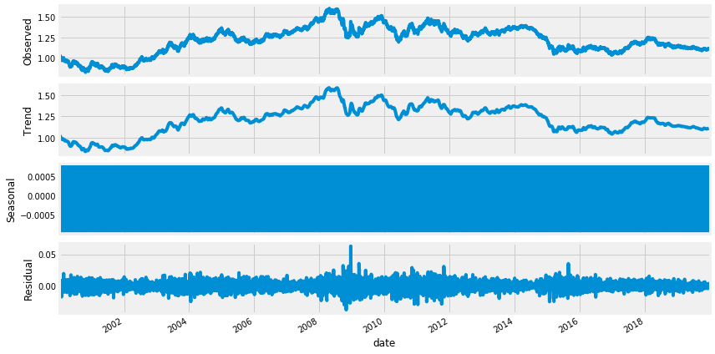

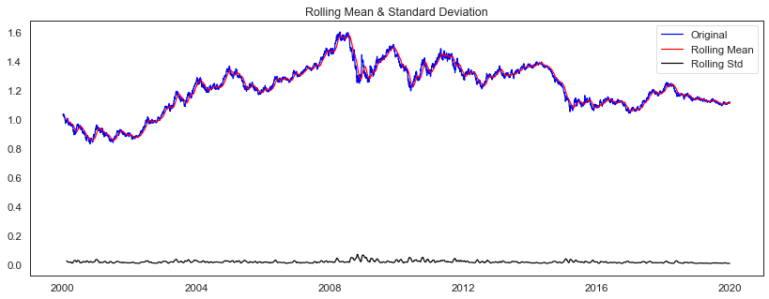


Exploratory Data Analysis
The charts below show the decomposition of the Time series into its different elements, and it demonstrates that the Time series is not stationary

Slide 7
Exploratory Data Analysis – Hypothesis Testing
Statistical Normality Test
Statistical normality test quantifies whether data was drawn from a Gaussian distribution
Hypothesis 2:
p <= alpha: reject H0, not normal.¶
p > alpha: fail to reject H0, normal
Result of hypothesis:
Data does not look Gaussian, we will reject the null hypothesis H0.

Slide 8
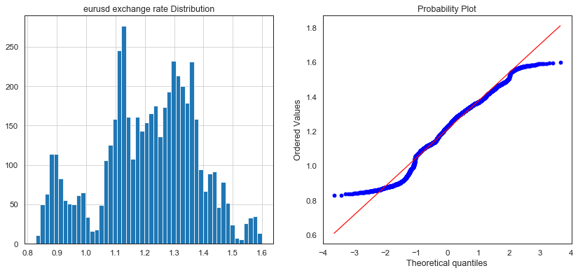
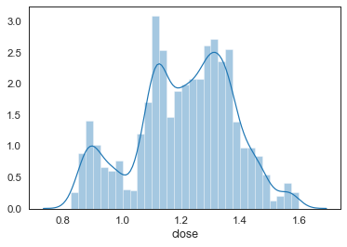
Exploratory Data Analysis
The kurtosis of the distribution is less than zero and is light tailed. The distribution is fairly symmetrical
Statistics=137.136, p=0.000
Kurtosis of normal distribution: -0.43668157335097213
Skewness of normal distribution: -0.28722463936355497

Slide 9
TIME SERIES ANALYSIS
Dataset was split into training and test set using 80% split in favor of training set
The auto-arima function generated the following Model: SARIMAX(1, 0, 0)x(2, 1, 1, 12)
The model was fitted on univariate series as only the “Open” Column of the dataset was considered.
The SARIMA Model produced a RMSE of : The RMSE of this model is: 0.005906521982 while the LSTM model produced 0.01606629

Slide 10
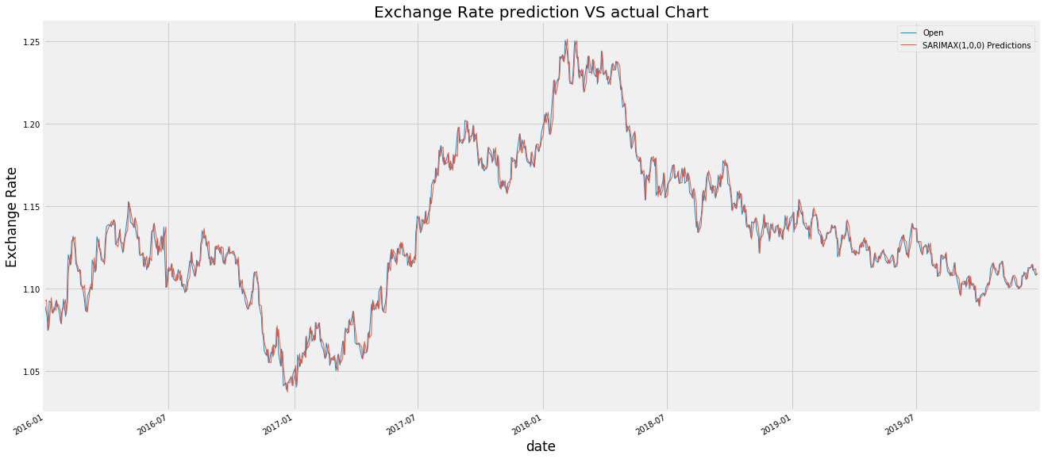
SARIMAX Model: Predictions compared with actual data

Slide 11
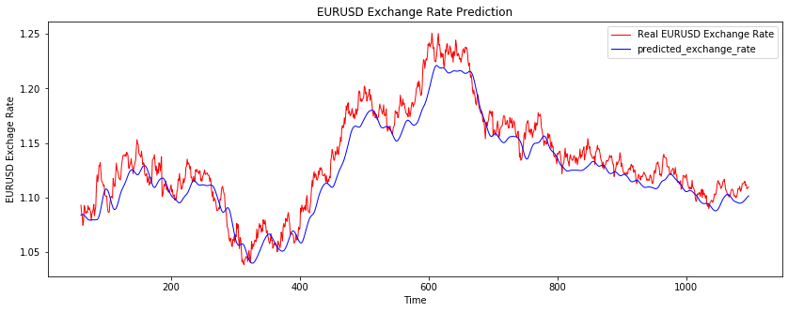
LSTM RNN Model: Predictions compared with actual data

Slide 12
Conclusion
LSTM model RSME is greater the SARIMAX model which implies SARIMAX Model performed better in predicting exchange rate, by minimizing errors
These two models could be useful for determining the turning points in the market.
It is not advisable to use specific prediction for investment purposes; however, they can be used as a guide, along with other technical and fundamental analysis to develop a point of view of the EURUSD Exchange rate.

Slide 13
Improvements to Model
The ARIMA model could be further improved by experimenting with various frequencies and ‘m’ values in order to determine the optimal values that would optimize the model. I was not able to do this because of system capacity issues.
The LSTM Model could be further improved by experimenting to obtain the optimal batch size / epoch and patience values. A model loss chart could be added to determine optimal levels.

